Slide 1
ANALYZE INTERNATIONAL DEBT STATISTICS

Slide 2
Objective:
It's not that we humans only take debts to manage our necessities. A country may also take debt to manage its economy. For example, infrastructure spending is one costly ingredient required for a country's citizens to lead comfortable lives. The World Bank is the organization that provides debt to countries. In this project, you are going to analyze international debt data collected by The World Bank. The dataset contains information about the amount of debt (in USD) owed by developing countries across several categories.
Benefits:
Informed decision making.
Debt Sustainability assessment.
Macroeconomic analysis.
Policy formation.
Comparative analysis.
Increased transparancy.

Slide 3
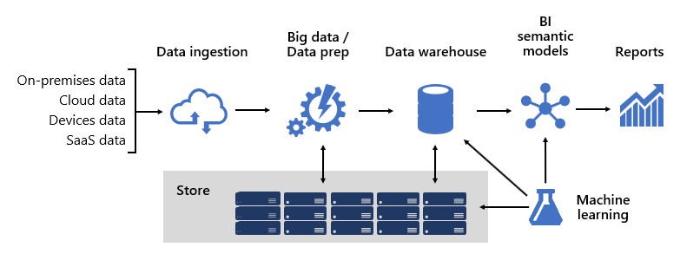
Architecture

Slide 4
Data Source
Dataset is available in the given link.
International Debt Statistics (IDS) | Data Catalog (worldbank.org)
Data Collection & Cleaning
Data is uploaded in mysql database through csv command line tool.
Data Analysis
This section provides a detailed analysis of the international debt statistics, including trends, patterns, and relationships between variables.

Slide 5
Data Visualization
This section presents the data in a visual format, using graphs, charts, and maps, to help communicate the results of the analysis to stakeholders.
Interpretation of Results
This section provides an interpretation of the results of the analysis, including a discussion of the implications and insights gained from the analysis.

Slide 6
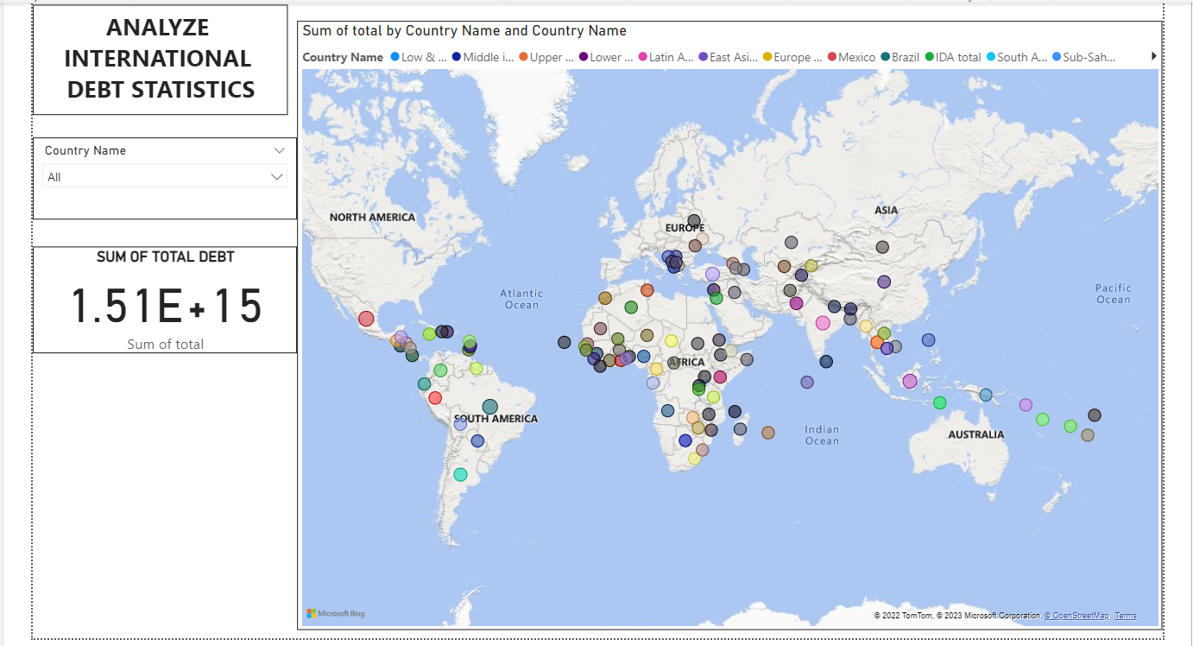
Results
From this analysis we can get information regarding total debt of individual country along with its location on map.

Slide 7
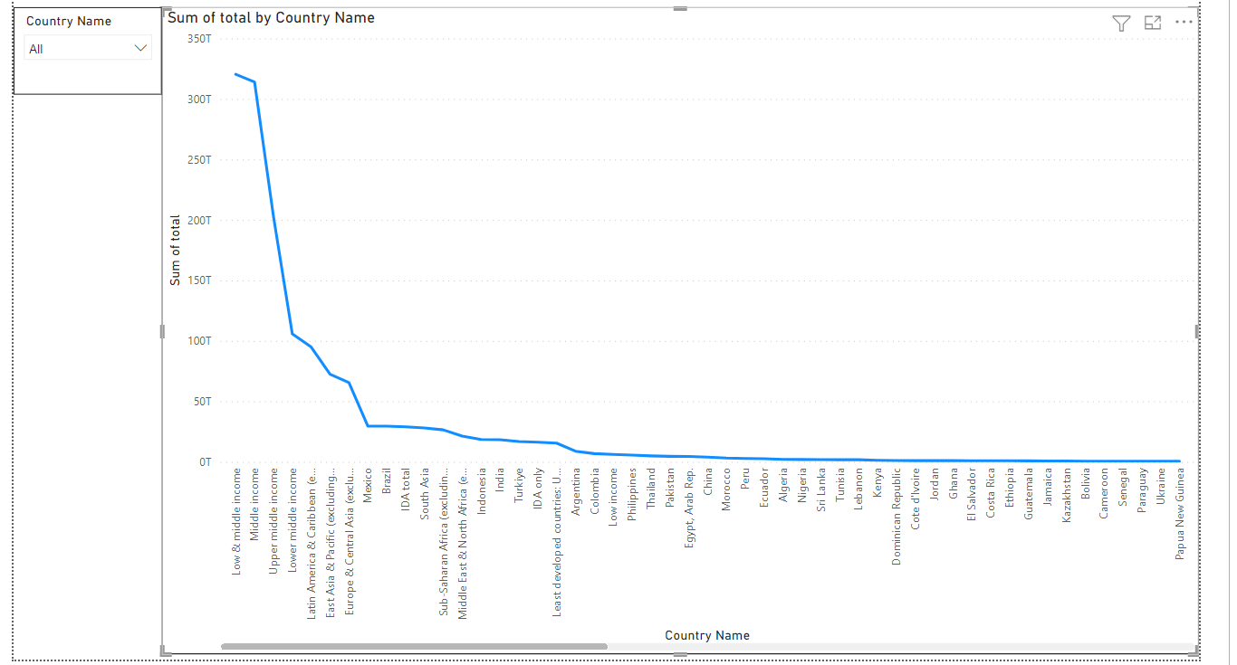
Results
From this analysis we can get information regarding total debt of individual country with respect to line chart.

Slide 8
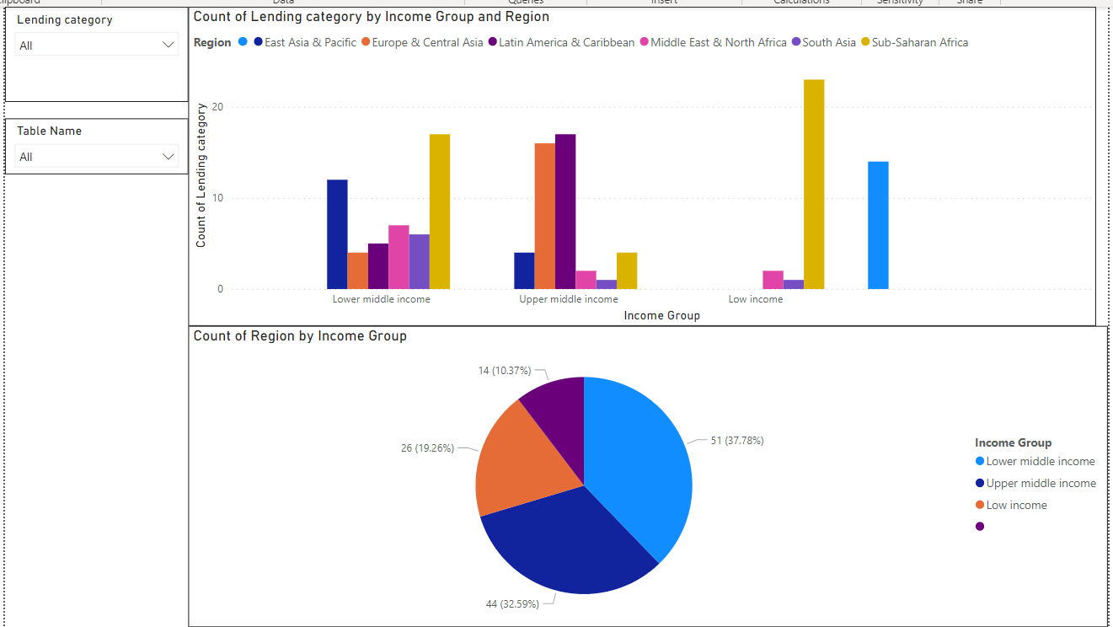
Results
From this analysis we can get information regarding lending categories with respect to income group & region.

Slide 9
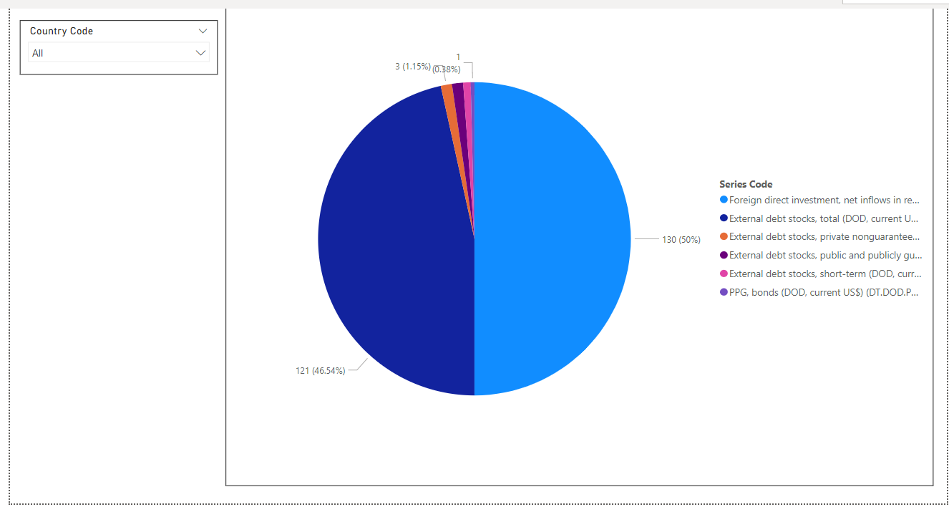
Results
From this analysis we can get information regarding debt of individual country with respect to series code.

Slide 10
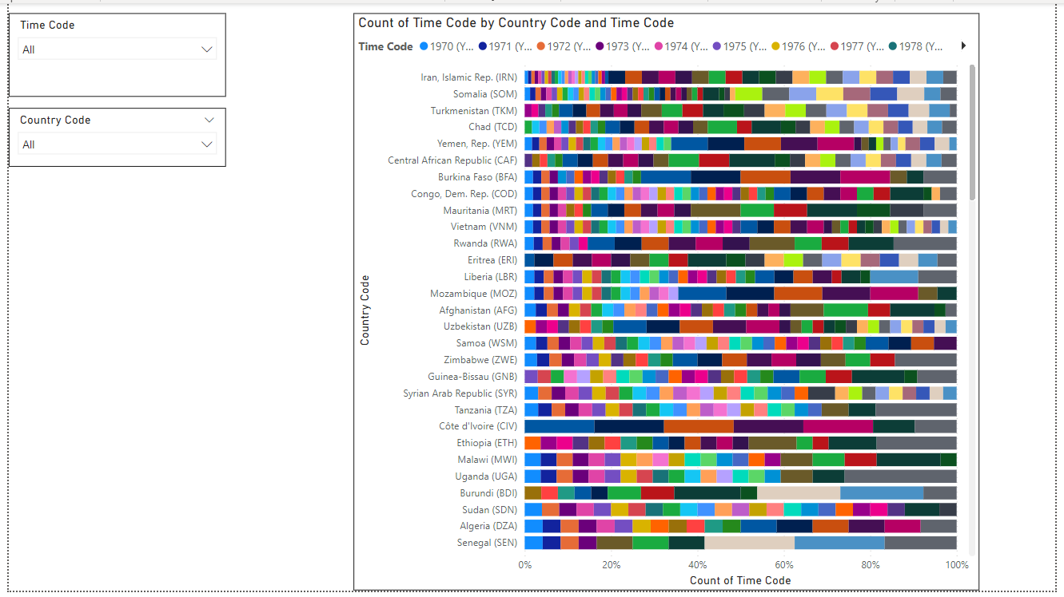
Results
From this analysis we can get information regarding time code with respect to individual country.

Slide 11
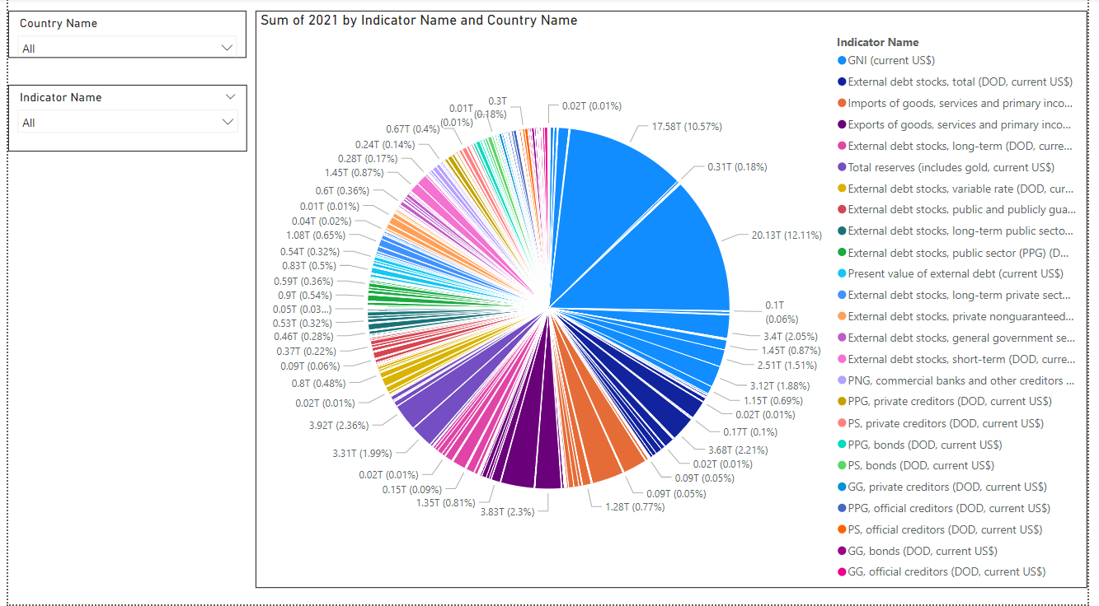
Results
From this analysis we can get information regarding debt of country of particular year with respect to indicator name.

Slide 12
Observation
From results we have observed that,
Sum of total debt of all countries is 1.51E +15 USD.
Maximum debt is taken by low & middle income countries.
Minimum debt is taken by Tonga.
There are three lending categories named Blend, IBRD, IDA.
Blend & IBRD have distributed debt to lower middle income & upper middle income countries.
IDA has distributed debt to low income, lower middle income & upper middle income countries.
If we analyzed by series code FDI has invested in maximum countries.

